Slide 1
finding the shortest path between an initial and a final point using A* algorithm
PRESENTED BY:
2010030490 KAJJAMVARUNKRISHNA
2010030494 SHASHIKANTH
2010030468 SATWIK
2010030463 M.ANIL KUMAR
GUIDED BY:
UDAYA RANI MA’AM
Notes:
Line spacing + Page numbers

Slide 2
TABLE OF CONTENTS
Problem statement
Algorithm used- its description
Flow chart of the proposed solution
Numeric example of the algorithm (Sample input - expected output)
Coding status and testing
Work progress
Github commits

Slide 3
PROBLEM STATEMENT
Search algorithms are algorithms designed to search for or retrieve elements from a data structure, where they are stored. They are essential to access desired elements in a data structure and retrieve them when a need arises.
A vital aspect of search algorithms is Path Finding, which is used to find paths that can be taken to traverse from one point to another, by finding the most optimum route.
It is a handy algorithm that is often used for map traversal to find the shortest path to be taken. A* was initially designed as a graph traversal problem, to help build a robot that can find its own course. It still remains a widely popular algorithm for graph traversal.

Slide 4
ALGORITHM USED
The algorithm used is A* Algorithm to find the shortest path between an initial and a final point.
It searches for shorter paths first, thus making it an optimal and complete algorithm. An optimal algorithm will find the least cost outcome for a problem, while a complete algorithm finds all the possible outcomes of a problem.
Another aspect that makes A* so powerful is the use of weighted graphs in its implementation. A weighted graph uses numbers to represent the cost of taking each path or course of action. This means that the algorithms can take the path with the least cost, and find the best route in terms of distance and time.

Slide 5
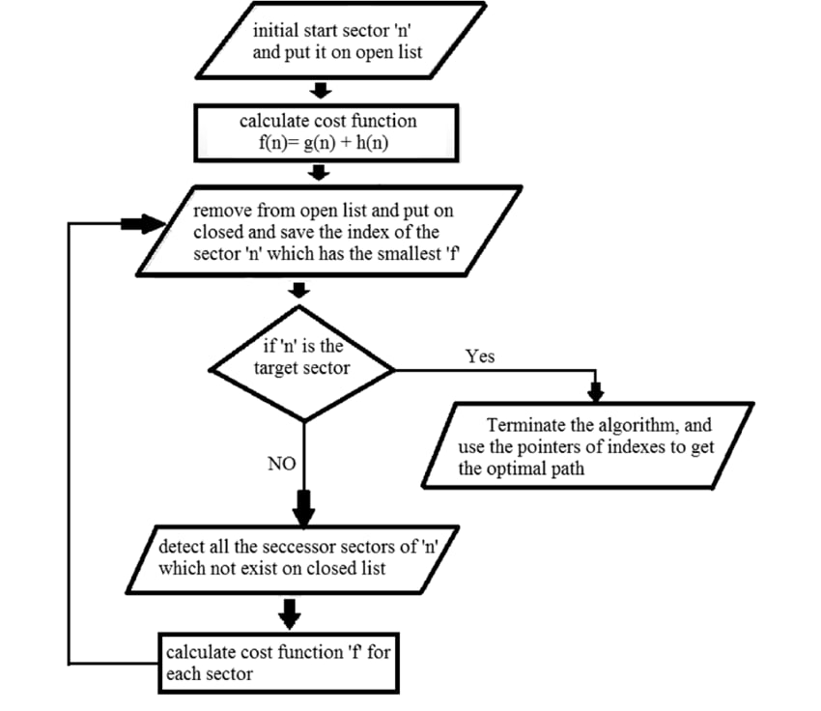
Flow chart of the proposed solution g (n) : The actual cost path from the start node to the current node. h ( n) : The actual cost path from the current node to goal node. f (n) : The actual cost path from the start node to the goal node.

Slide 6
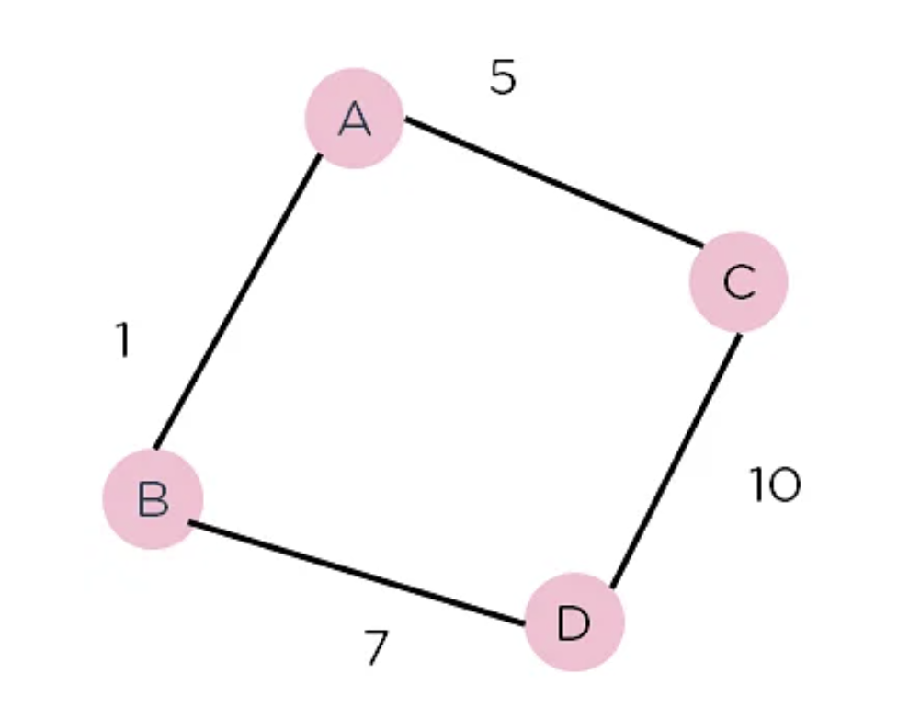
Numeric example of the algorithm (Sample input - expected output)
Consider the weighted graph depicted above, which contains nodes and the distance between them.
Let's say you start from A and have to go to D.
Now, since the start is at the source A, which will have some initial heuristic value. Hence, the results are
f(A) = g(A) + h(A) f(A) = 0 + 6 = 6
Next, take the path to other neighbouring vertices :
f(A-B) = 1 + 4
f(A-C) = 5 + 2
Now take the path to the destination from these nodes, and calculate the weights :
f(A-B-D) = (1+ 7) + 0
f(A-C-D) = (5 + 10) + 0
It is clear that node B gives you the best path, so that is the node you need to take to reach the destination.

Slide 7
CODING AND TESTING

Slide 8
WORK PROGRESS

Slide 9
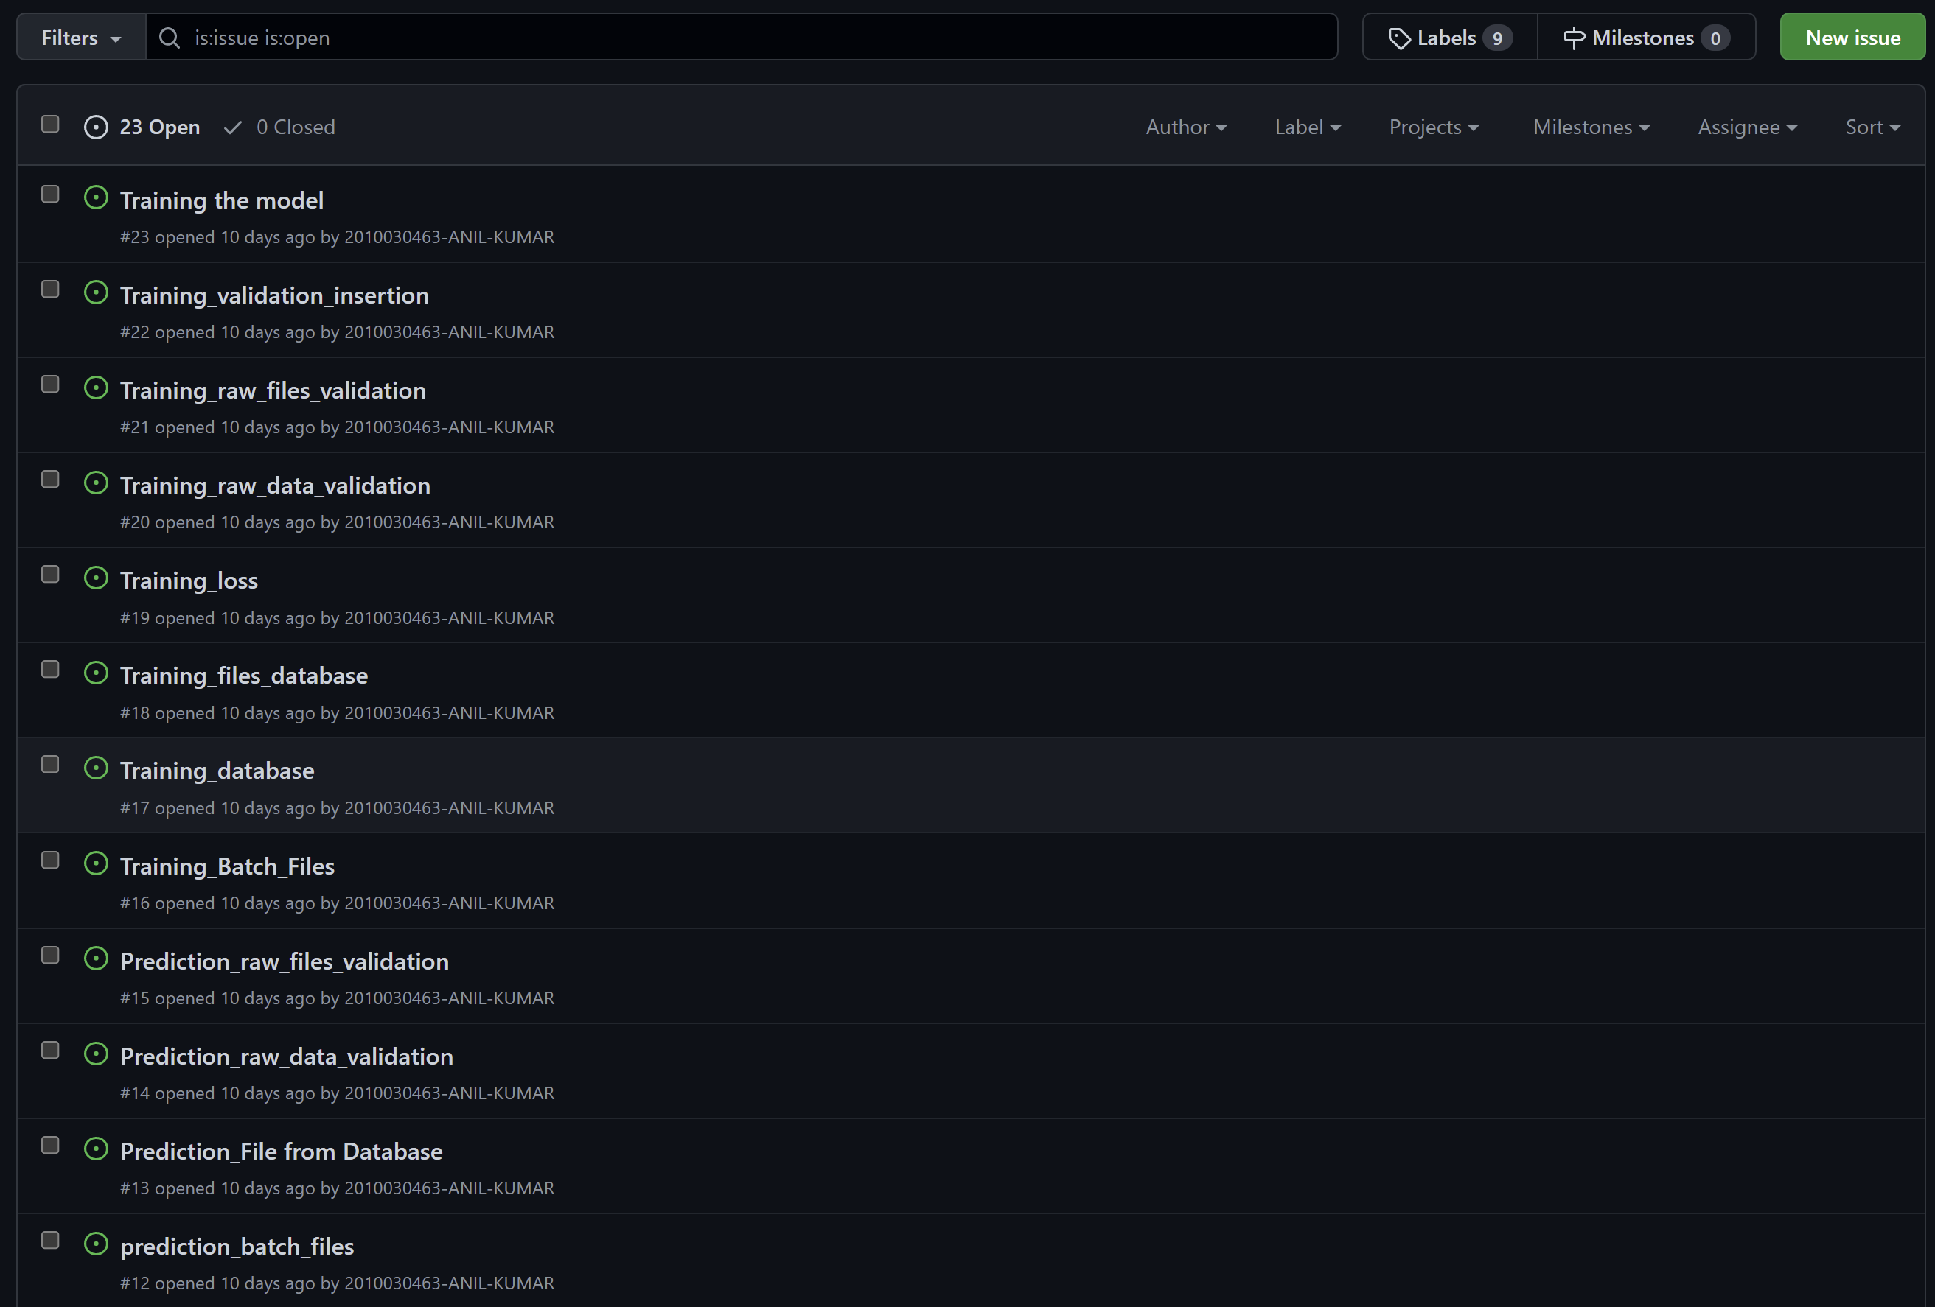
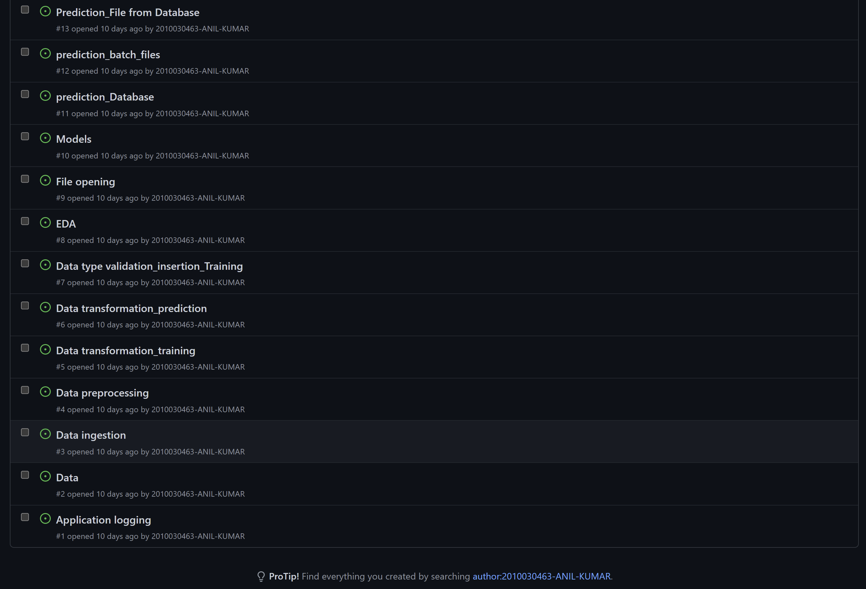
GITHUB COMMITS

Slide 10
THANK YOU..

